Slide 1
MAGIC Tutorial
MATLAB

Slide 2
MAGIC (Markov Affinity-Based Graph Imputation of Cells
MAGIC imputes missing data values on sparse data sets, restoring the structure of the data
It also proves dimensionality reduction and gene expression visualizations
MAGIC can be performed on a variety of datasets
Here, we show the effectiveness of MAGIC on epithelial-to-mesenchymal transition (EMT) data
To use MAGIC, cite:
MAGIC: A diffusion-based imputation method reveals gene-gene interactions in single-cell RNA-sequencing data
Biorxiv (preprint) February 2017. DOI: doi.org/10.1101/111591

Slide 3
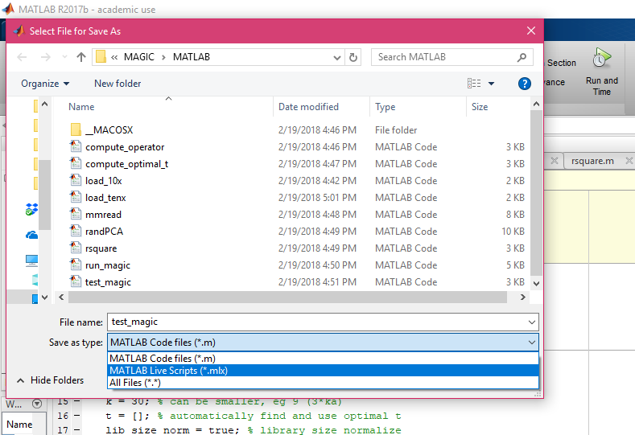
Installation
Go to: https://github.com/KrishnaswamyLab/magic/tree/master/matlab
Download all files
Perform analysis through test_magic.m
test_magic.m can be saved as a live script for a more intuitive interface:

Slide 4
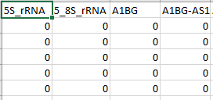
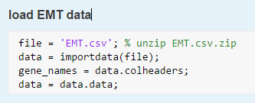
Loading Data
Data can be loaded as a .csv file using importdata()
10x data can be loaded in using load_10x()
Categories must be specified separately from numerical data
Cell names are loaded as rows
Gene names are loaded as columns
Example: EMT data

Slide 5
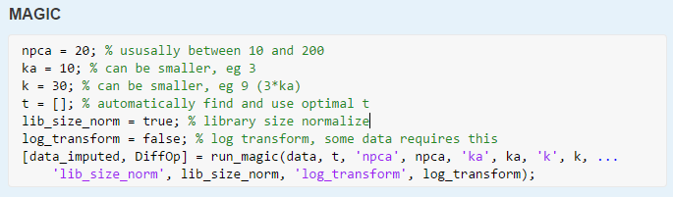
EMT: Analysis
The following parameters are required to run MAGIC
npca: Number of PCA components (default = 20)
ka: Distance of kth nearest neighbor in adaptive kernel (default = 10)
k: (default = 30)
t: number of diffusion steps (specified automatically through optimal t analysis)
lib_size_norm: library size normalization (default = TRUE)
log_transform: apply log transformation to data (default = FALSE)
Rescale percent: percentile of the original data that the maximum value of each gene is rescaled to (default = 0.99)

Slide 6
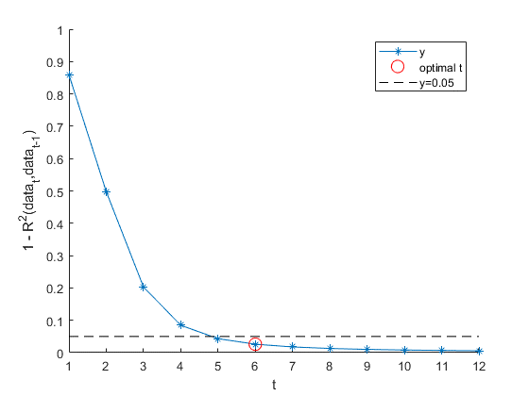
EMT: Optimal t analysis
The optimal value of t is found separately and is automatically applied to the analysis

Slide 7

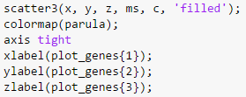
EMT: Visualization
Specify genes to be plotted
Extract “before MAGIC” data from “data” matrix and “after MAGIC” data from “data_imputed” matrix
Create 2-D and 3-D scatter plots using scatter() and colormap()
Note: for 2-D scatter plots, “z” and “zlabel” should be omitted

Slide 8
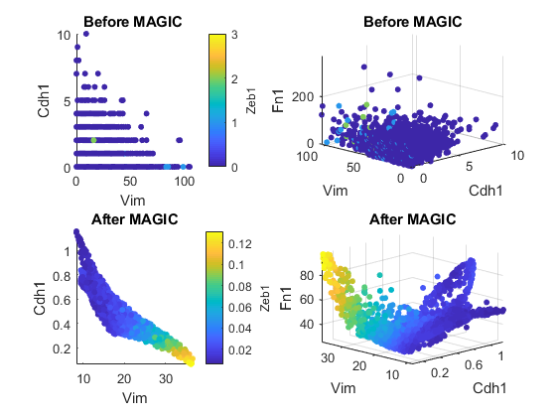
EMT: Visualization
Data (gene-gene relationships) can be visualized using 2-dimensional or 3-dimensional scatter plots
Raw data and MAGIC-transformed data can be easily compared

Slide 9
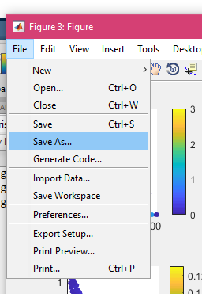
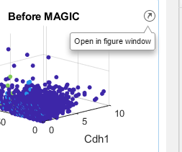
Saving plots
Plots can be saved from the live editor as MATLAB figures or image files (.bmp)
Upper right-hand corner of figure
In figure window:
File > Save as

